Slide 1
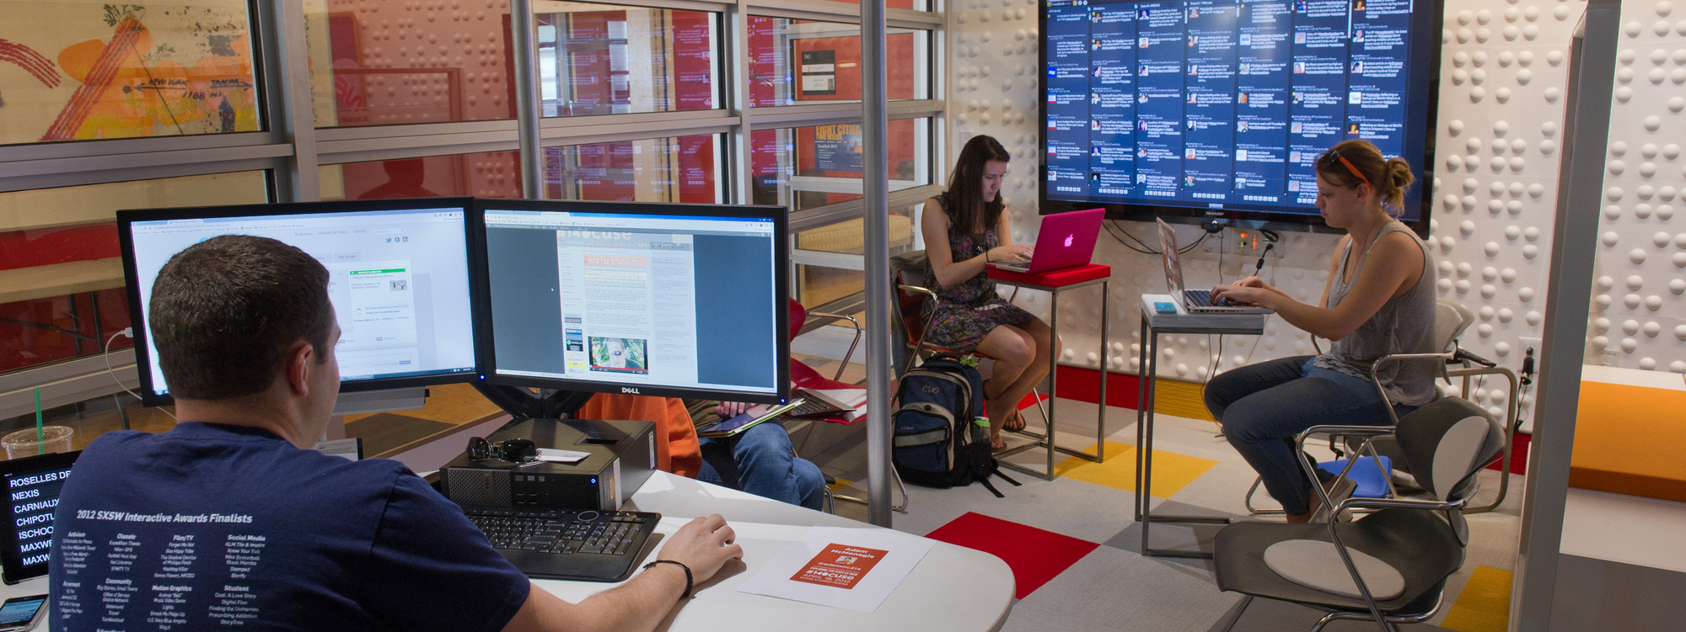
Applied Data Science Harsh | Jash | Shrutik | Charan | Priyanka

Slide 2
OVERVIEW
Problem Statement and Scope
Query Results
NPS
Questions

Slide 3
PROBLEM STATEMENT
Performing data analysis to find out prime reasons for existing customers’ reviews
Scope of our project is limited to hotels in United States
Focus is on those customers whose likelihood to recommend is less than 8 (Passives & Detractors)

Slide 4
Top 5 Cities with most Detractors
City | Detractors | Passive
San Francisco | 19% | 26%
Atlanta | 12% | 17%
New York | 11% | 26%
San Diego | 10% | 19%
San Antonio | 9% | 25%

Slide 5
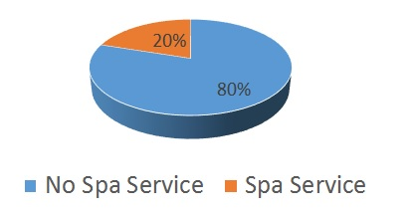
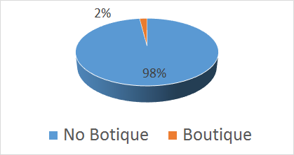
Sample Queries Results
80% of the customers (couples) whose purpose of visit was Leisure could be detractors because the hotel had no Spa Service
98% of the Female customers whose purpose of visit was Leisure might be detractors because the hotel had no Boutique

Slide 6
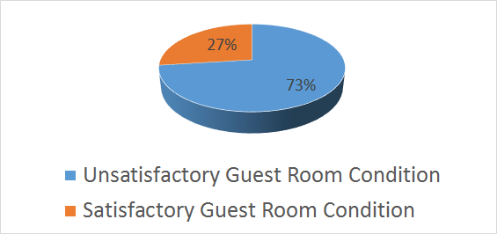
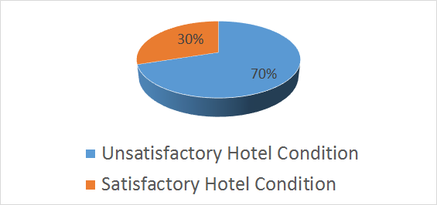
Sample Queries Results
73% of the customers in San Diego whose purpose of visit was Business were possibly detractors because of poor guest rooms
70% of the customers in San Francisco whose purpose of visit was Business were possibly detractors because of poor condition of hotel

Slide 7
NPS
On a scale of 0 to 10 with 10 being extremely likely, how likely are you to recommend our company to a friend or colleague?
Why did you give us that score?
What can we do to earn a 10?
Notes:
On a scale of 0 to 10 with 10 being extremely likely, how likely are you to recommend our company to a friend or colleague?
Why did you give us that score?
What can we do to earn a 10?

Slide 8
"Desired Spa Service: Y" [1] "Current Spa Service: N"

Slide 13
fun(sfData,94133) [1] "Desired Overall Satisfaction: 8.59375" [1] "Current Overall Satisfaction: 7.80392156862745" [1] "Desired Tranquility: 8.45454545454546" [1] "Current Tranquility: 6.8" [1] "Desired Hotel Condition: 8.904" [1] "Current Hotel Condition: 6.52941176470588" [1] "Desired Customer Service: 8.992" [1] "Current Customer Service: 7.80392156862745" [1] "Desired Staff Cared: 8.72058823529412" [1] "Current Staff Cared: 7.80952380952381“ [1] "Desired Convention_PL: Y" [1] "Current Convention_PL: N" [1] "Desired Pool.Outdoor_PL: N" [1] "Current Pool.Outdoor_PL: Y" [1] "Desired Regency.Grand.Club_PL: Y" [1] "Current Regency.Grand.Club_PL: N" [1] "Desired Self.Parking_PL: Y" [1] "Current Self.Parking_PL: N"
>

